Slide 1
REST Continued!
Oxford University
Software Engineering Programme
April 2021

Slide 2
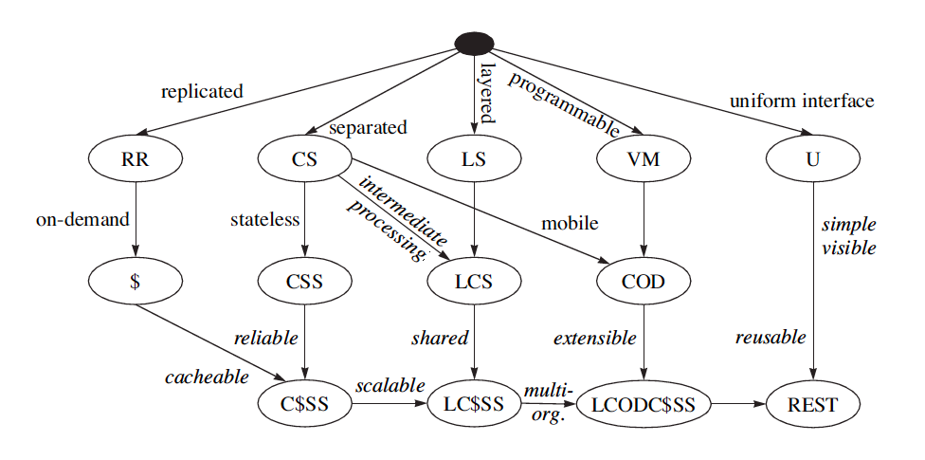
REST Derivation from Style Constraint

Slide 3
Key concepts
Client Server
Caching
Replicable
Stateless
Layered
Uniform interface

Slide 4
Cacheing
Large scale network systems often rely on cacheing
Reduce traffic
Localised access
Reduced processing
Akamai and others make the web work effectively
Caching relies on differentiating between cacheable and not cacheable traffic
Also understanding the lifetime and status of cacheable objects

Slide 5
HTTP cacheing features
Expires header
Cache-control header
If-modified-since / Not modified
ETags (Entity Tags)
Uuids for content
Strong and Weak
If None Match
Unfortunately some websites are using Etags to track users instead of cookies!

Slide 6
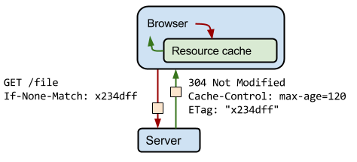
ETags
https://developers.google.com/web/fundamentals/performance/optimizing-content-efficiency/images/http-cache-control.png

Slide 7


Slide 8
Statelessness
Of course there is state!
The only question is where the state is kept.
Traditional CS systems required the client and server to be kept in sync
The web uses cookies

Slide 9
Layered systems
Reverse proxies
Composable
E.g. my business process is a service that exposes a REST interface and co-ordinates other services
Compare with web scraping

Slide 10
Representation
State of resource captured and transferred between components
Might be current or desired future state
Represented as data plus metadata (name–value pairs)
Metadata includes control data, media type
The Content-Type of the resource should be useful and meaningful (self-description)
One resource might have several representations
Selected via separate URIs, or via content negotiation

Slide 11
Uniform Interface
A Uniform, Constrained Interface. When applying REST over HTTP, stick to the methods provided by the protocol
GET, POST, PUT, and DELETE.
These should be used properly
GET should have no side effects or change on state
PUT should update the resource “in-place”

Slide 12
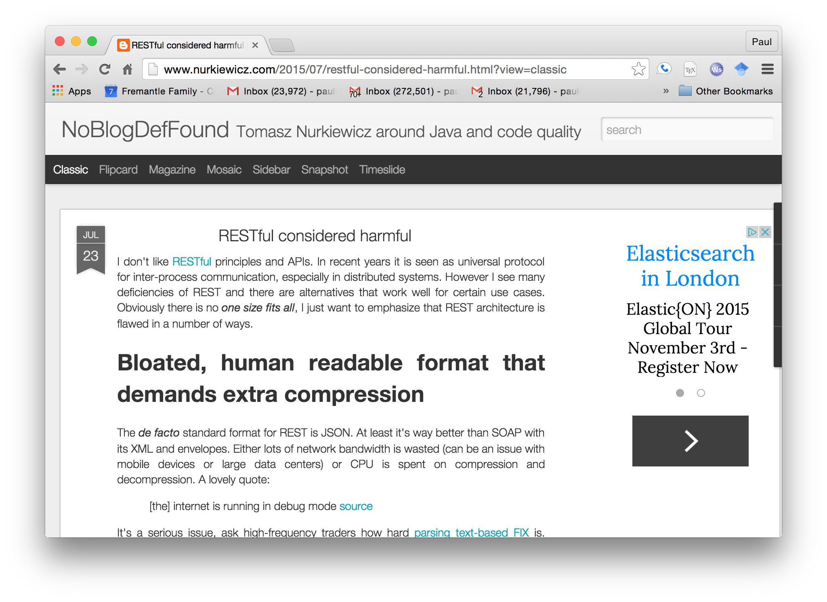
Not everyone agrees: http://www.nurkiewicz.com/2015/07/restful-considered-harmful.html

Slide 13
Anti-REST concerns
Bloated formats (equally applies to SOAP)
Neither Schema nor Contract
APIs and discovery instead of clear published machine-readable documentation
No inbuilt batching, paging, sorting, etc
CRUD only
HTTP Status codes mixed with business replies
Temporal Coupling
Not clear enough what is REST and what isn’t!
Backwards compatibility

Slide 14
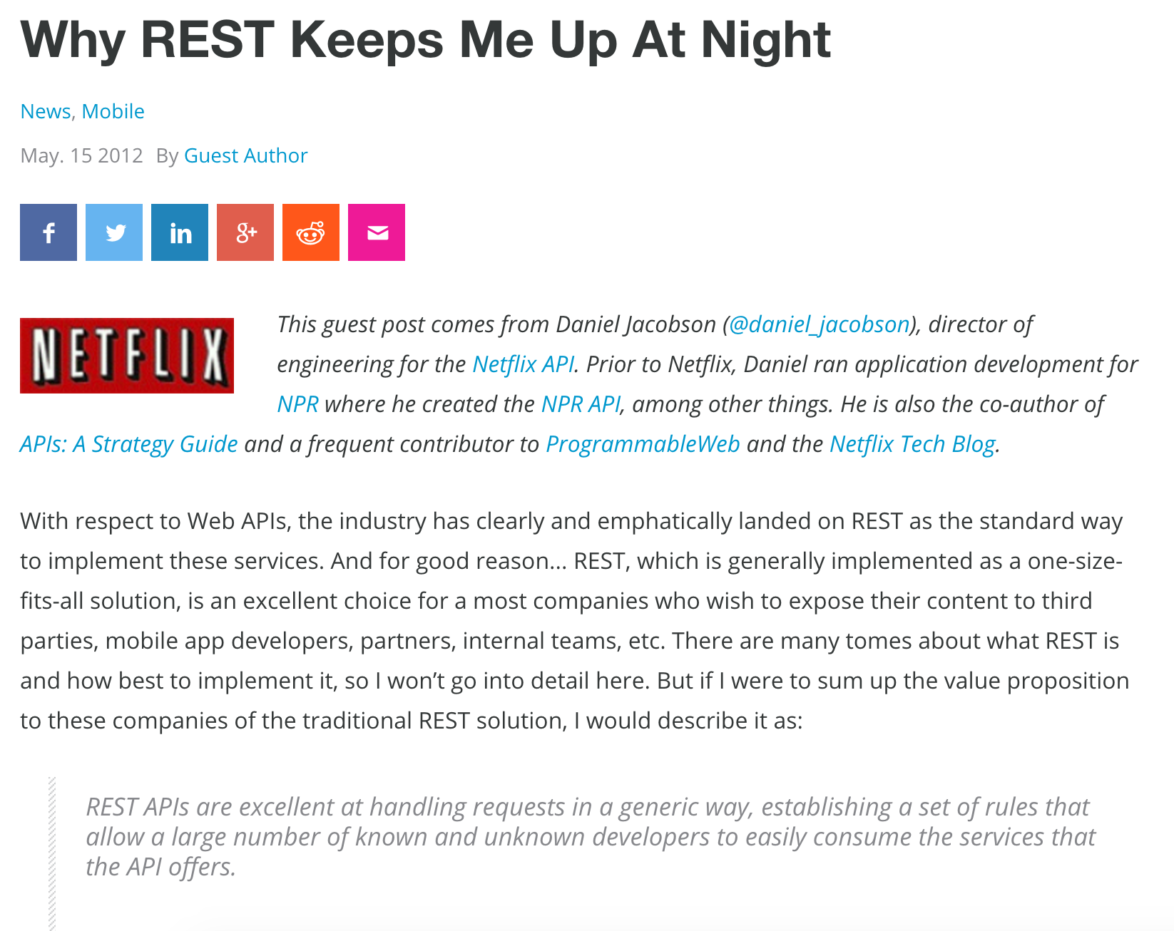
http://www.programmableweb.com/news/why-rest-keeps-me-night/2012/05/15

Slide 15
Alternatives to REST
gRPC
Async and Events
GraphQL

Slide 16
gRPC and Events
Covered in other lectures

Slide 17
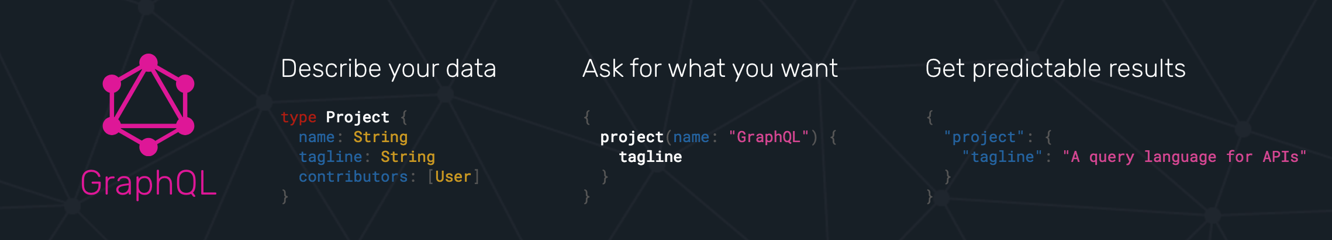

GraphQL

Slide 18
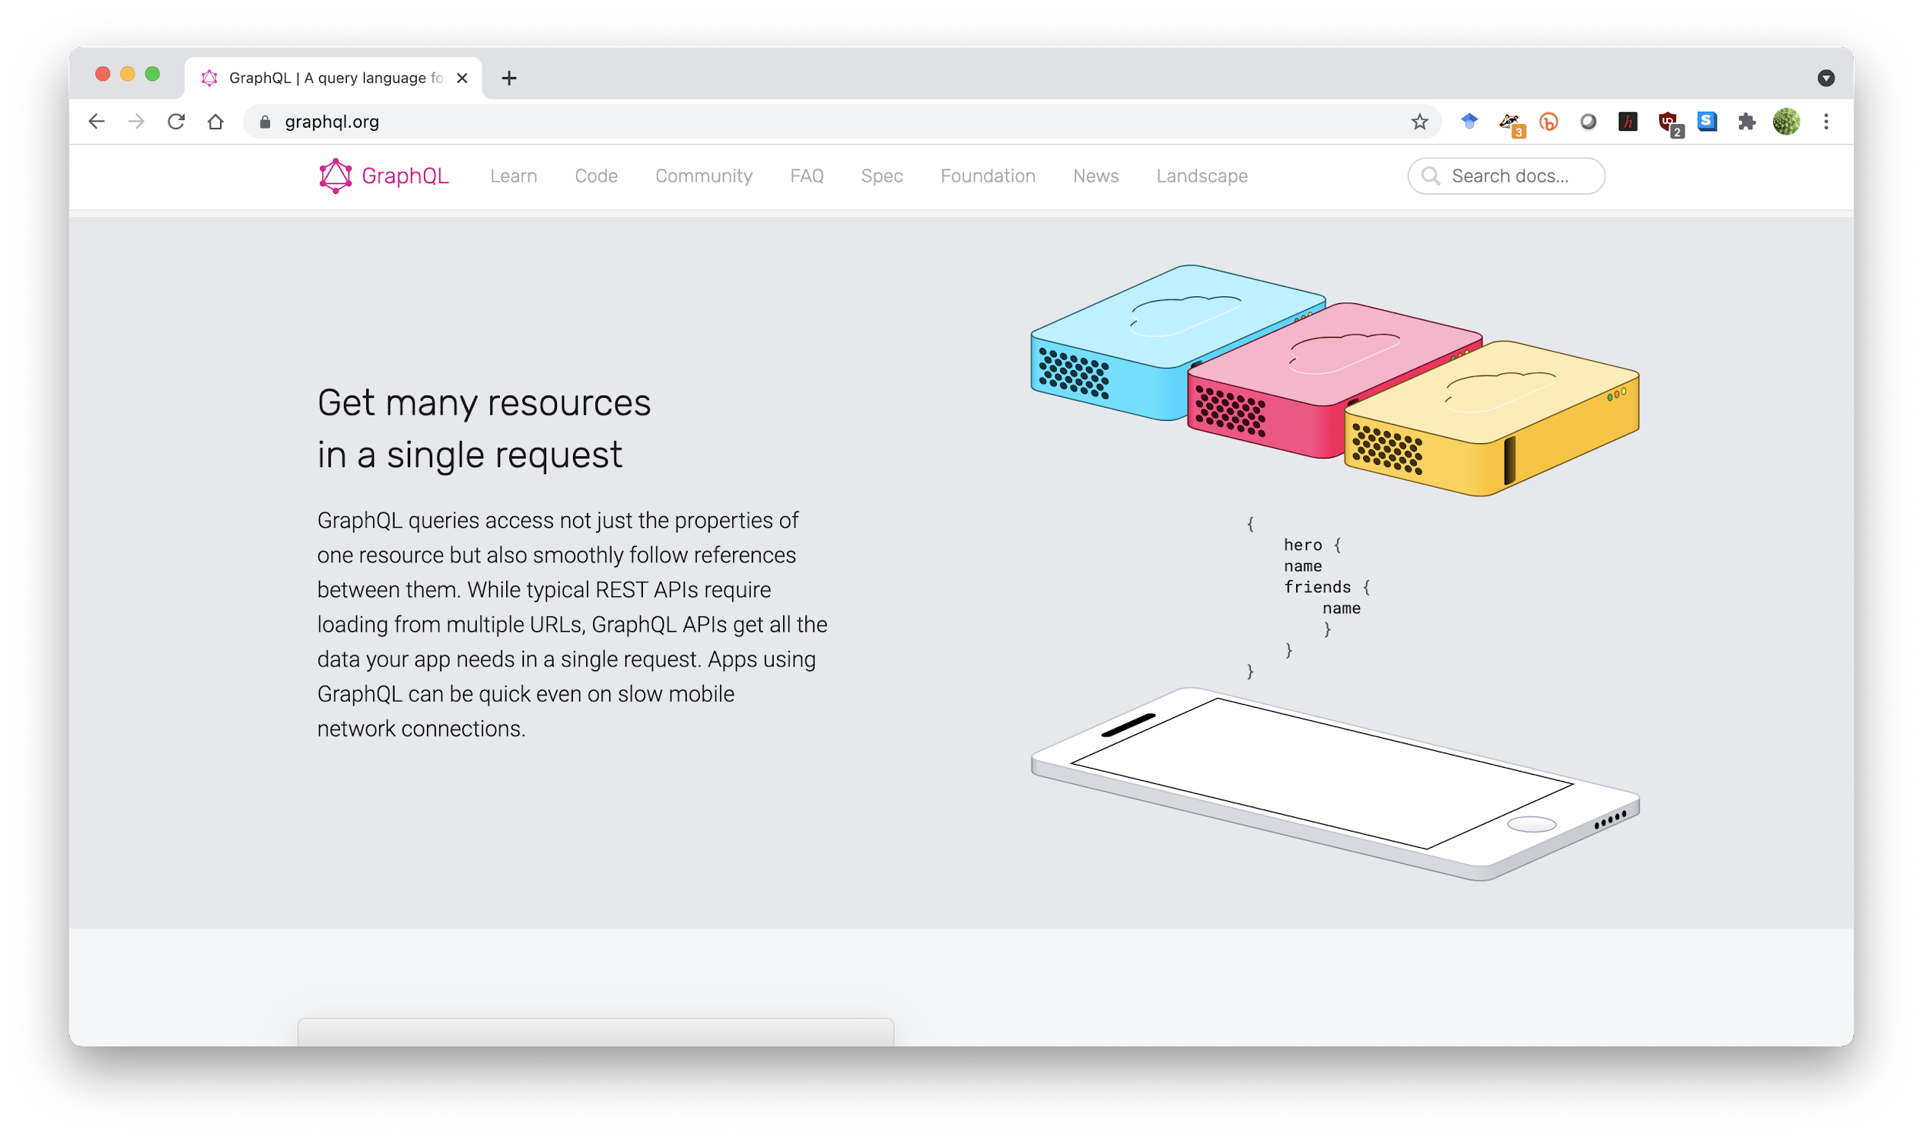

Slide 19
GraphQL
A Facebook developed language
Supports getting many resources with a single call
Allows the caller to specify what data is needed
A single endpoint to access multiple resources with a well defined type system

Slide 20
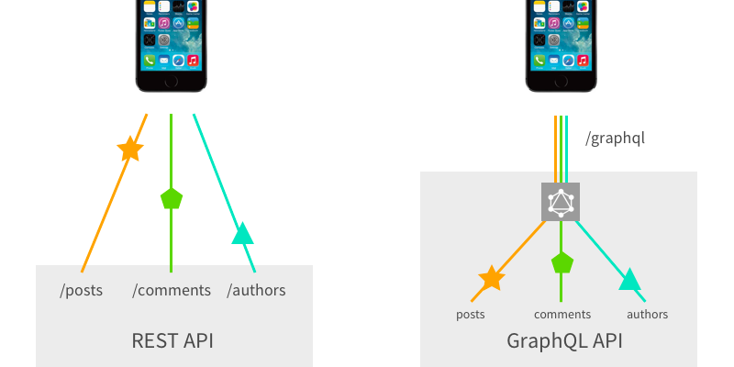
GraphQL vs REST
https://blog.apollographql.com/graphql-vs-rest-5d425123e34b

Slide 21
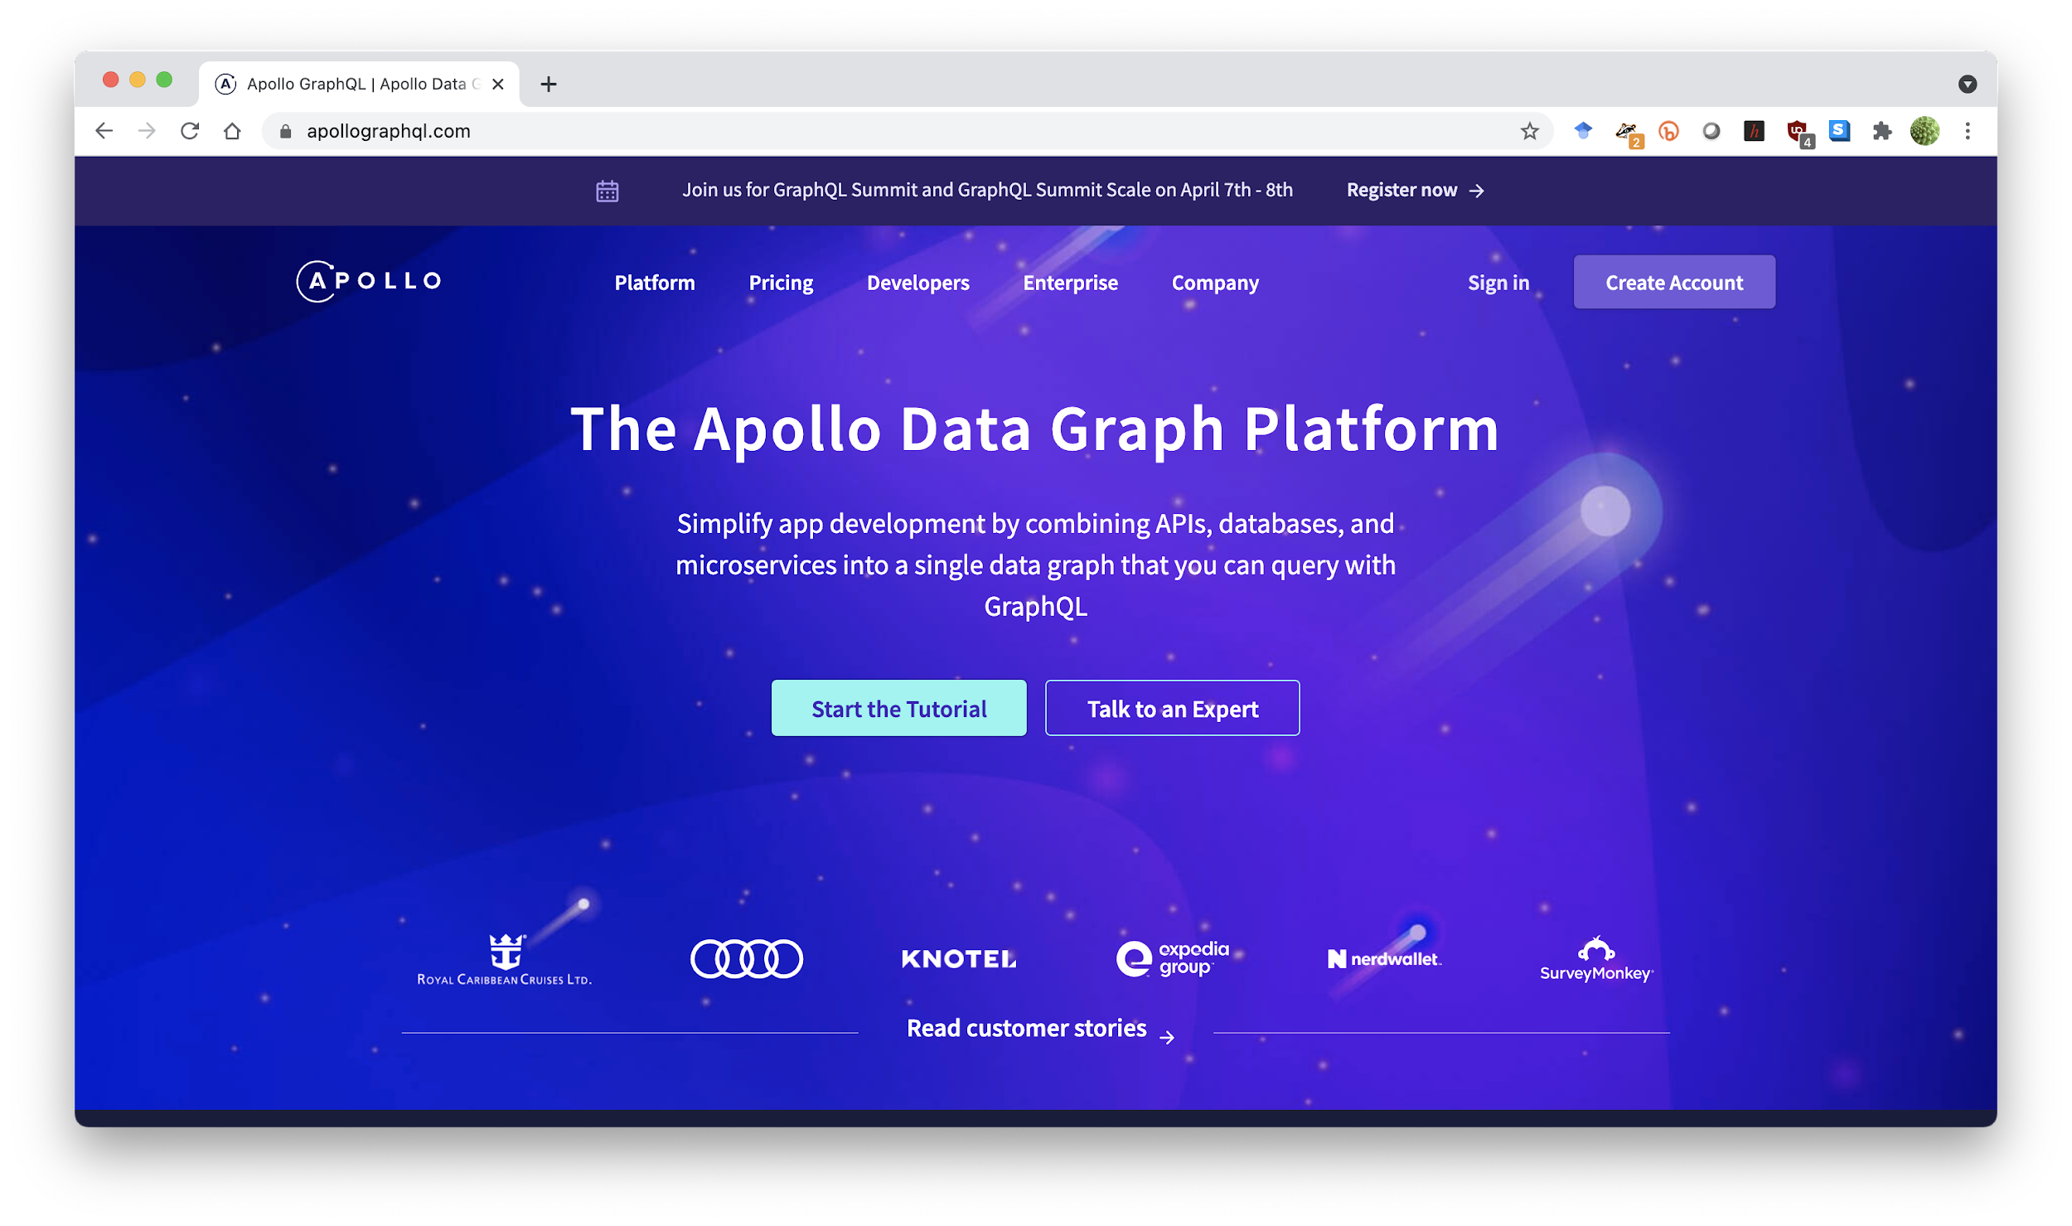

Slide 22
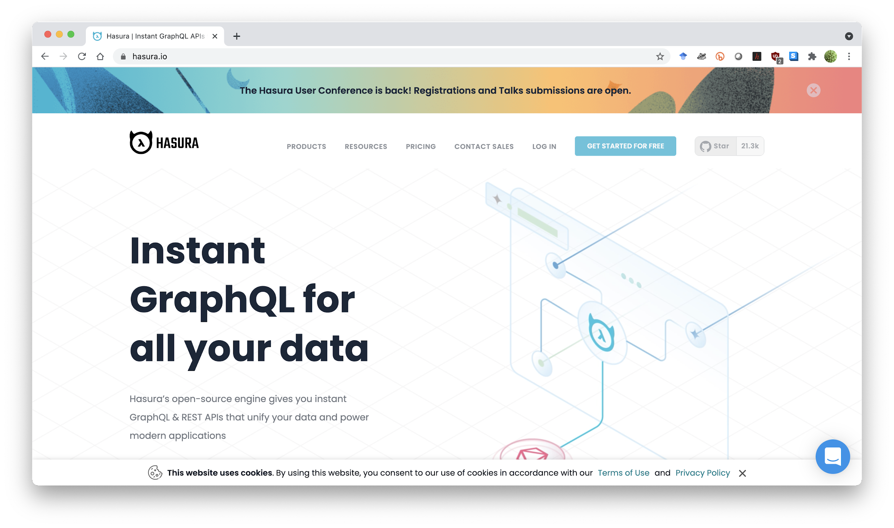

Slide 23
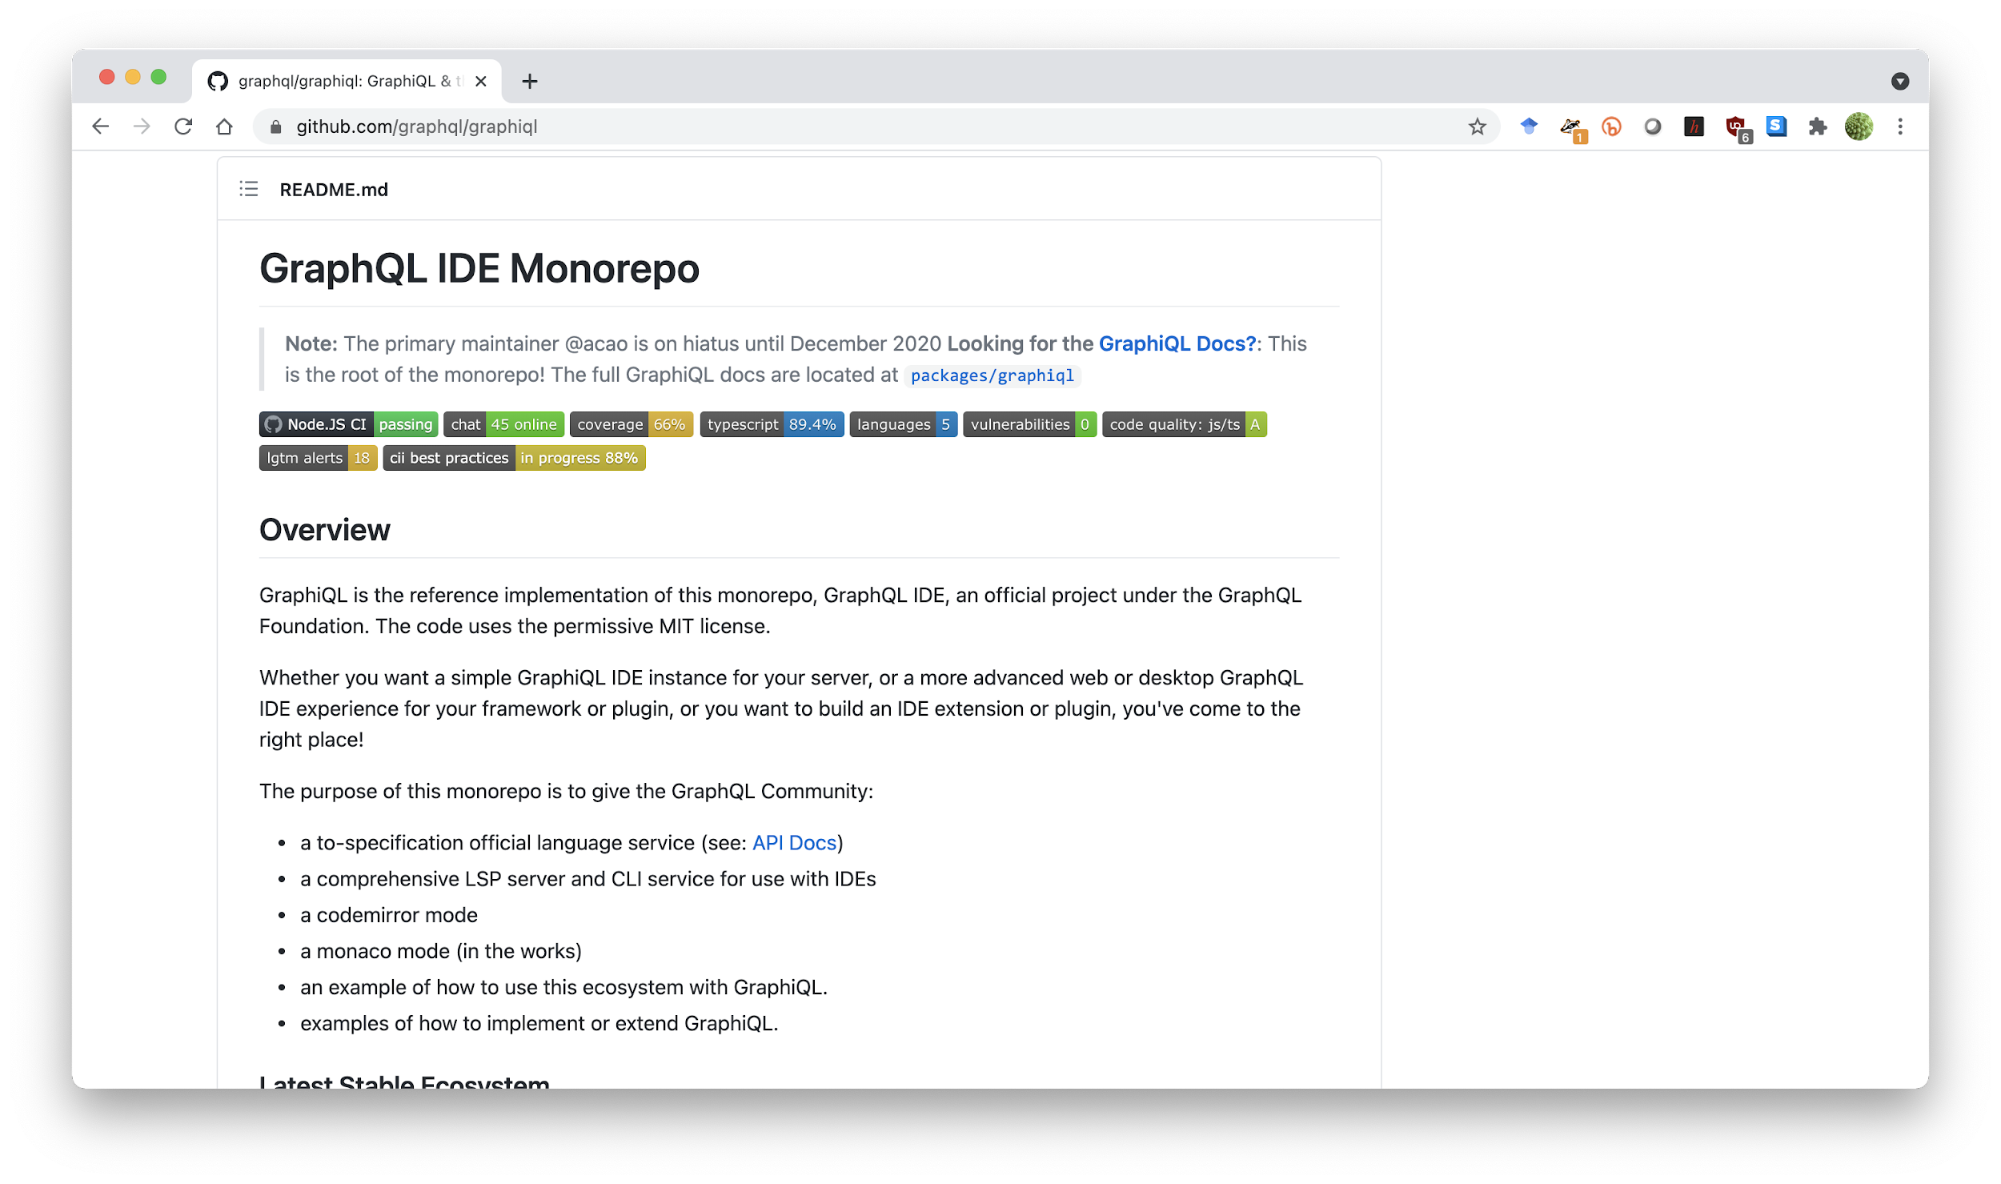

Slide 24
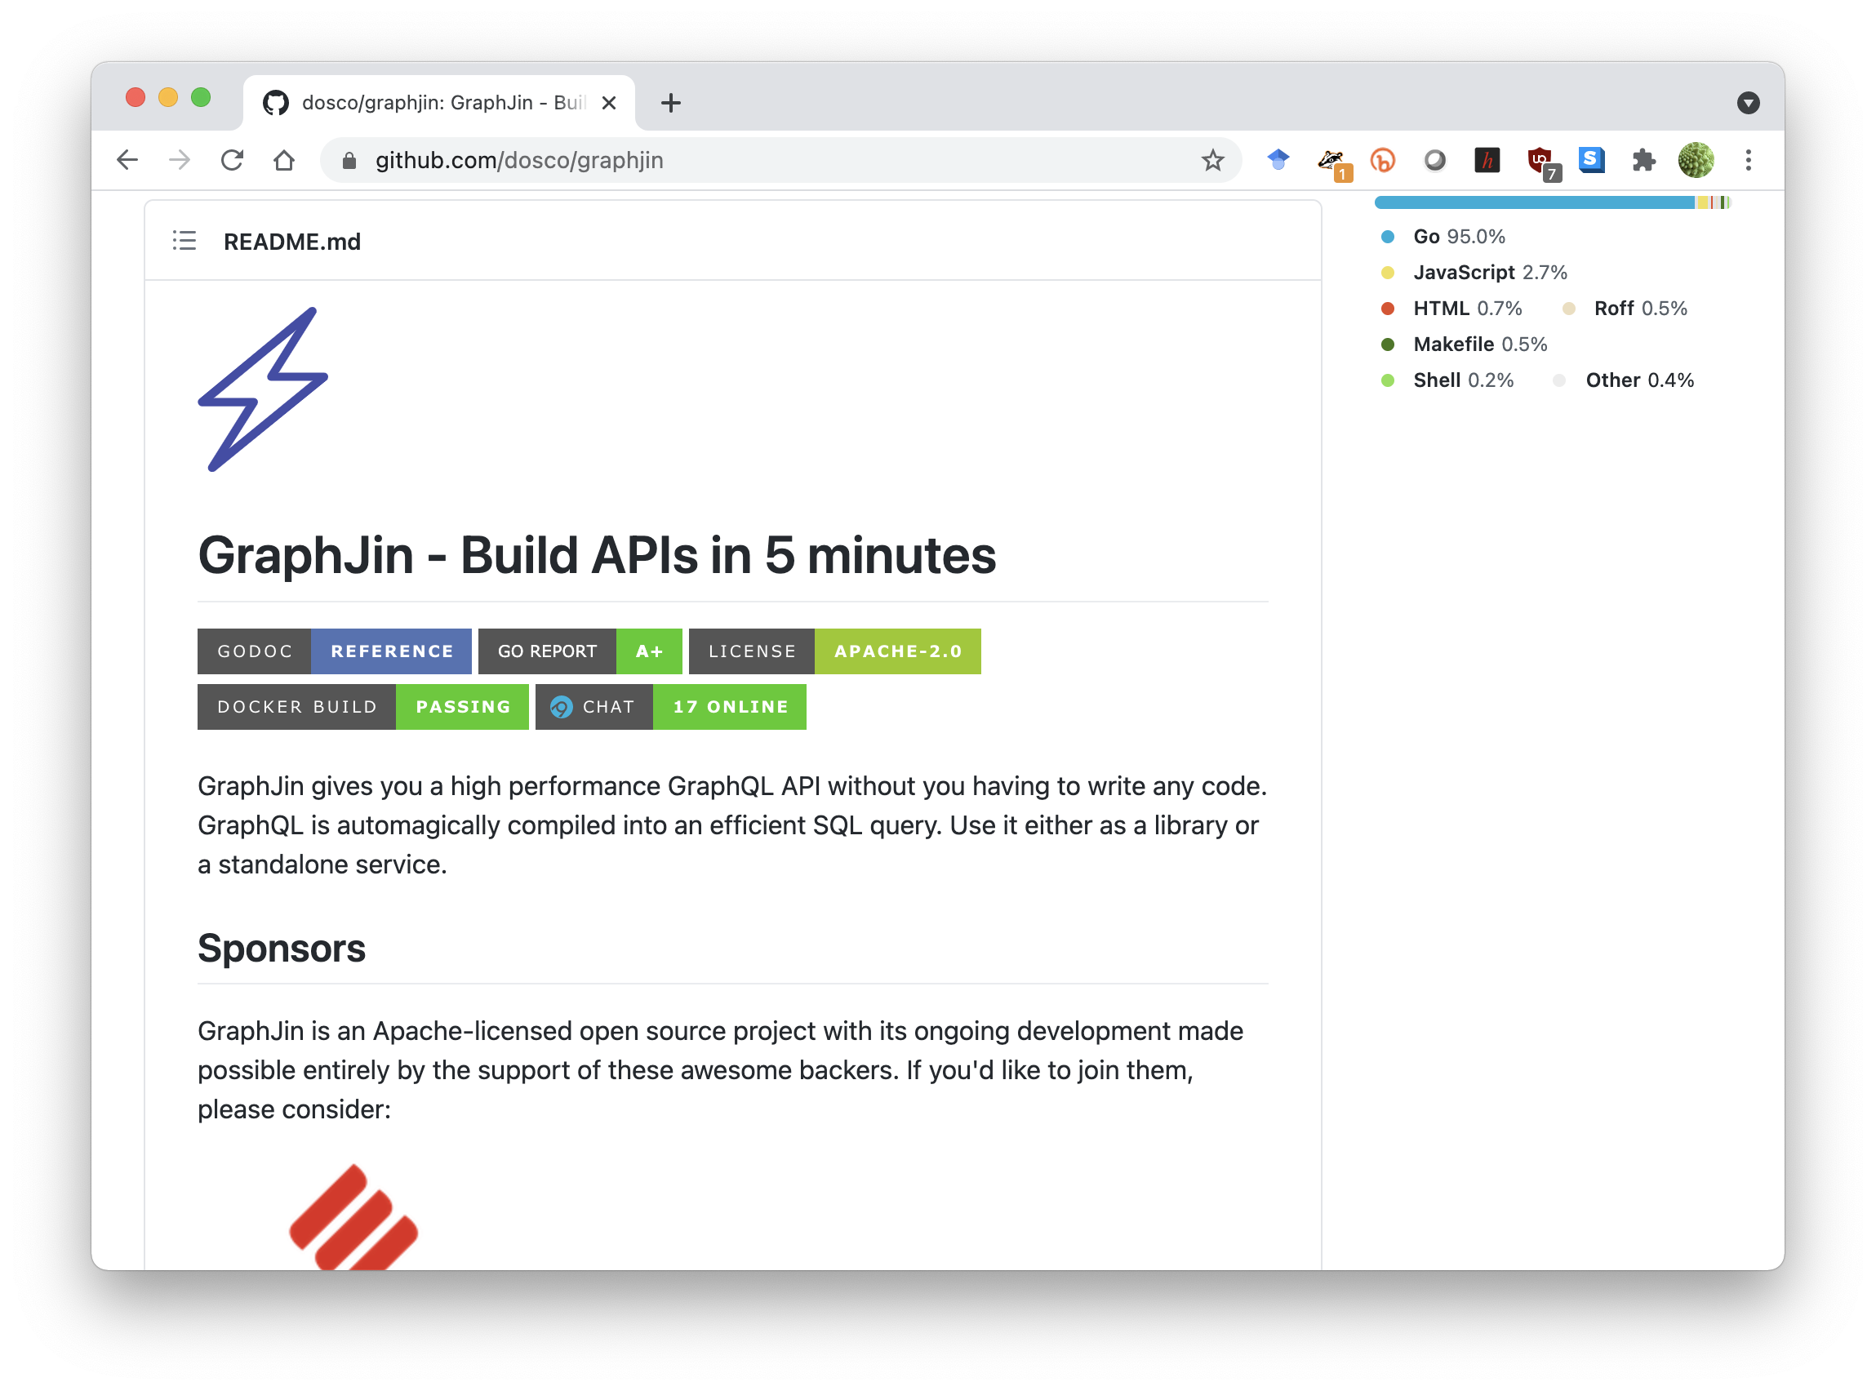

Slide 25
Questions?

